Slide 1
Customer Analysis of Nova Tech Electronics Limited
CUSTOMER ANALYSIS FOR NOVA TECH ELECTRONICS LIMITED

Slide 2
This section present an analysis of customers of Nova Tech Electronic Limited. The analysis focuses on knowing who our customers are, their satisfaction rate, preferred shipment mode, interaction with customer care, and total cost of product bought by customers.
INTRODUCTION
Ikey areas covered include;
*Customer demography (Gender)
*Customer satisfaction
*Product Importance
*Shipment mode
*Shipment promptness
*Warehouse block usage
*Customer care calls
*Total cost of product
an analysis of customer behavior for Nova Tech Electronics Limited

Slide 3
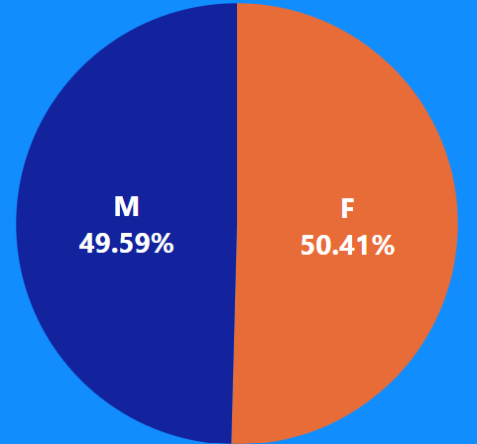
CUSTOMER BY GENDER
Notes:
. There are more female customers than male but only small difference.

Slide 4

CUSTOMER SATISFACTION RATING
Notes:
. More customers were not satisfied with products than those satisfied.

Slide 5
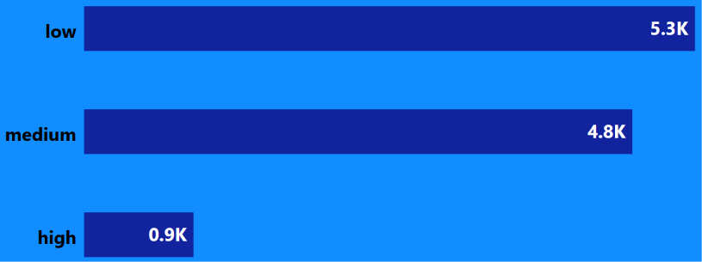
PRODUCT IMPORTANCE
Notes:
. Products of LOW importance was purchased more by customers.
. Products of HIGH importance has the lowest purchase rate with a very significant difference compared to products of LOW and MEDIUM importance.

Slide 6
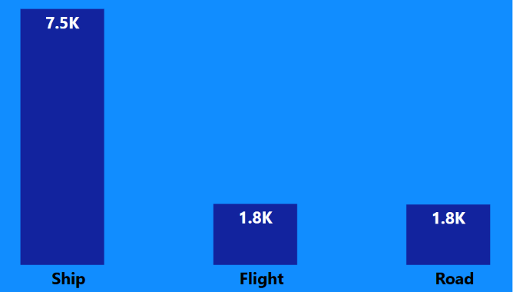
PREFERED SHIPMENT MODE
Notes:
. More products were shipped through SHIP compared to others.
. The two other mode of shipment (FLIGHT & ROAD) were equally used.

Slide 7
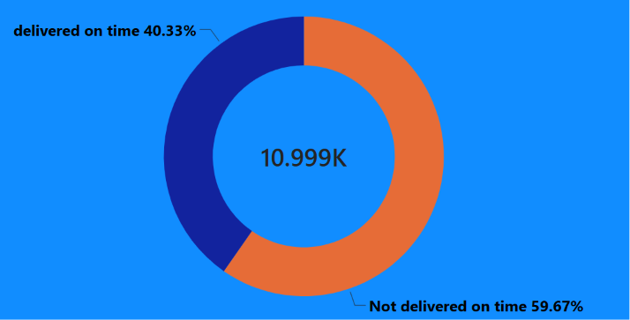
SHIPMENT PROMPTNESS
Notes:
. The shipment promptness is poor as more products were not delivered on time compared to those delivered on time.

Slide 8
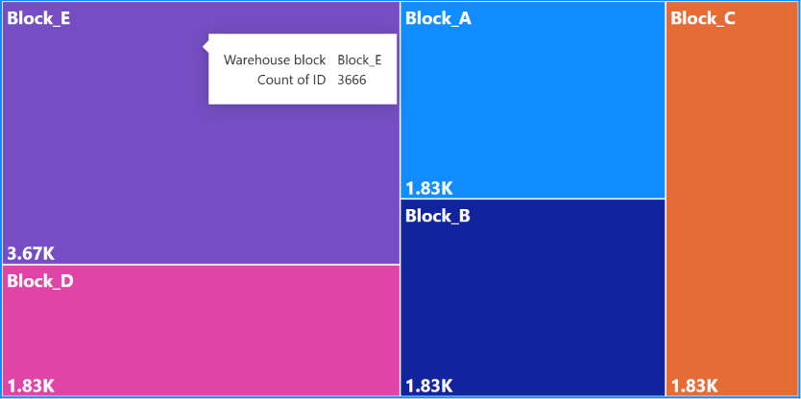
WAREHOUSE BLOCK USAGE
Notes:
. Block E was the warehouse Block used the Most.
. Other blocks were equally utilized.

Slide 9
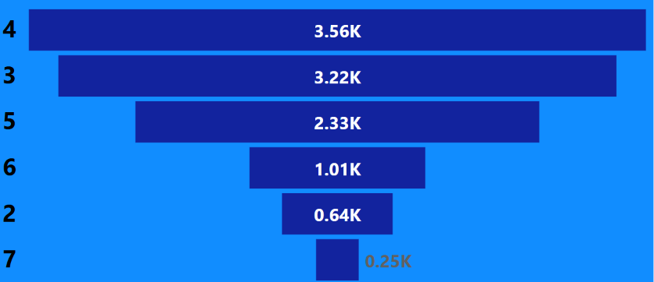
CUSTOMER CARE CALLS
Notes:
. Every Customers made use of the customer care call line which shows that it is important that the customer care should be active always so that customers can make enquiries or complaints about products.

Slide 10

TOTAL COST OF PRODUCT
Notes:
. The total cost of product bought by customers is 2.31 millions in USD excluding discounts.

Slide 11
Conclusion
    The quality of products should be improved upon so that customers will be satisfied.
The delivery promptness should be improved upon to ensure that products are delivered in time.
  Customer care line should remain active and reachable for customers.

